Slide 1
Chapter 8: Ethical, Social, and Political Issues in E-commerce
Week 8
Ethics, Law, and E-commerce
Trends: From Many to Few
Copyright © 2010 Pearson Education, Inc.

Slide 2
Understanding Ethical, Social, and Political Issues in E-commerce
Internet, like other technologies, can:
Enable new crimes
Threaten social values
Costs and benefits must be carefully considered, especially when there are no clear-cut legal or cultural guidelines

Slide 3
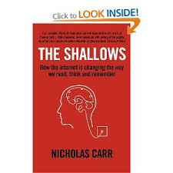
Nicholas Carr; The Shallows
“The computer screen bulldozes our doubts with its bounties and convenience. It is so much our servant that it would seem churlish to notice that it is also our master.”

Slide 4
Video
https://www.youtube.com/watch?v=cKaWJ72x1rI
https://www.youtube.com/watch?v=zGY_RjqlSRU
https://www.youtube.com/watch?v=HjJYvLH_FGw

Slide 5

Who can save us from social media?
At this point, perhaps just us
Nicholas Carr argues it may be too late for regulation as platforms took hold so quickly, outpacing our ability to spot darker effects on society, democracy

Slide 6
Who can save us from social media?
By removing barriers to communication, social media has enabled us to let loose our worst instincts and transmit to a huge audience whatever thoughts comes to mind.
Notes:
https://www.google.com/search?q=nicholas+carr+superbloom&rlz=1C1CHZL_enIE756IE756&oq=&gs_lcrp=EgZjaHJvbWUqCQgAEEUYOxjCAzIJCAAQRRg7GMIDMgkIARBFGDsYwgMyCQgCEEUYOxjCAzIJCAMQRRg7GMIDMgkIBBBFGDsYwgMyCQgFEEUYOxjCAzIJCAYQRRg7GMIDMgkIBxBFGDsYwgPSAQkyNDM5ajBqMTWoAgiwAgHxBXcOVCnkOlwE&sourceid=chrome&ie=UTF-8#fpstate=ive&vld=cid:82dcc22f,vid:r7itUteiCTY,st:0

Slide 7
Who can save us from social media?
Our phones — pull us in both directions, providing us with a simulation of sociability while exacerbating our loneliness, and capture our attention on the cheap.
Book publishers & Hollywood producers may have always been preoccupied with the question of how to sustain an audience’s attention, but social media entrepreneurs don’t have to bother with anything so mysterious (and expensive):
“They can simply throw a million little interruptions at us, track which ones grab our attention & then repeat.”

Slide 8


Slide 9
“The Sirens’ Call, by Chris Hayes
“Increasingly over the course of time I’ve been on air, my competition isn’t just what other cable news shows are on during that time, but literally every single piece of content available in any media: every movie ever made, every TV show ever made, every video on TikTok or Instagram, every app and video game available.”

Slide 10
A Model for Organizing the Issues
Issues raised by Internet and
e-commerce can be viewed at individual, social, and political levels
Four major categories of issues:
Information rights
Property rights
Governance
Public safety and welfare

Slide 11
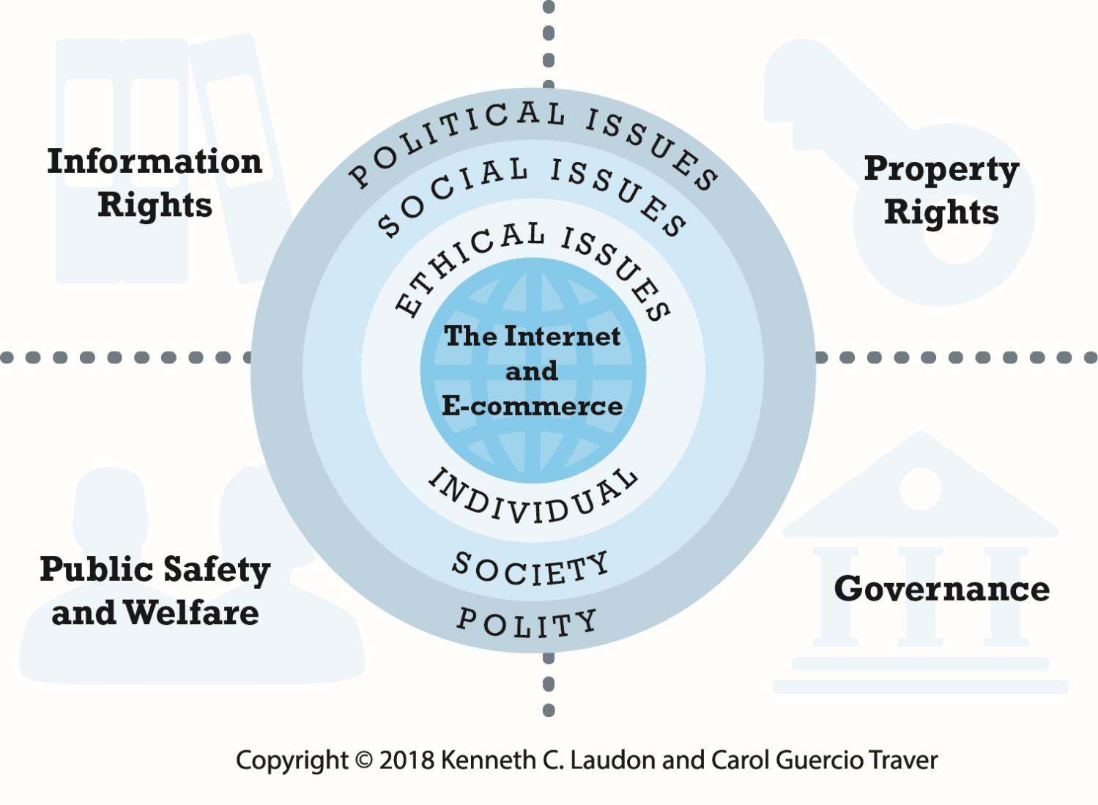
The Moral Dimensions of an Internet Society
Notes:
Figure 8.1, Page 500.
The introduction of the Internet and e-commerce impacts individuals, societies, and political institutions. These impacts can be classified into four moral dimensions: property rights, information rights, governance, and public safety and welfare.

Slide 12
A Model for Organizing the Issues
Four major categories of issues:
Information rights – your personal info
Property rights – how can it be enforced on internet
Governance –should internet be subject to public law?
Public safety and welfare; gambling, porn, child safety, bullying

Slide 13
Basic Ethical Concepts
Ethics
Study of principles used to determine right and wrong courses of action;
Responsibility
Accountability
Liability
Due process

Slide 14
Basic Ethical Concepts
Ethics
Study of principles used to determine right and wrong courses of action; decisions can be judged against a variety of different principles
Responsibility; we are free moral agents & responsible for decisions we make
Accountability;
Liability
Laws permitting individuals to recover damages
Due process
Laws are known, understood
Ability to appeal to higher authorities to ensure laws applied correctly

Slide 15
Analyzing Ethical Dilemmas
Process for analyzing ethical dilemmas:
Identify and clearly describe the facts
Define the conflict or dilemma and identify the higher-order values involved
Identify the stakeholders
Identify the options that you can reasonably take
Identify the potential consequences of your options

Slide 16
Privacy and Information Rights
Privacy:
Moral right of individuals to be left alone, free from surveillance or interference from other individuals or organizations
Information privacy: Four premises
Right to control information collected about them
“Right to be forgotten”
Right to know when information is collected and give consent
“Informed consent”
Right to personal information due process
Right to have personal information stored in a secure manner
https://en.wikipedia.org/wiki/Right_to_be_forgotten
Notes:
The right to be forgotten "reflects the claim of an individual to have certain data deleted so that third persons can no longer trace them.
The form asks people to select one of the twenty-eight countries that make up the European Union, as well as Iceland, Liechtenstein, Norway, and Switzerland"The form allows an individual or someone representing an individual to put in a request" for the removal of any URLs believed to be a violation of the individual's privacy.^{[23]} Regardless of who is submitting the form, some form of photo identification of the person the form is being submitted for must be presented. The purpose of this is to provide proof that the person for whom the request is being made does in fact approve.

Slide 17
Information Collected at E-commerce Sites
Data collected includes
Personally identifiable information (PII)
Anonymous information
Types of data collected
Name, address, phone, e-mail, social security
Bank and credit accounts, gender, age, occupation, education
Preference data, transaction data, clickstream data, browser type

Slide 18
Key Issues in Online Privacy of Consumers
Top concerns
Profiling and ad targeting
Social network privacy
Sharing of information by marketers
Mobile phone privacy
Other concerns
Monitoring employees
Sharing of health information
Surveillance to prevent terrorism

Slide 19
Marketing: Profiling, Behavioral Targeting, and Retargeting
Facial recognition tools
Business perspective:
Increases effectiveness of advertising, subsidizes content
Enables sensing of demand for new products
Critics' perspective:
Undermines expectation of anonymity and privacy
Enables price discrimination
The harm of false data

Slide 20
Social Networks and Privacy
Social networks
Encourage sharing personal details
Pose unique challenge to maintaining privacy
Personal control over personal information vs. organization’s desire to monetize social network

Slide 21
Mobile and Location-based Privacy Issues
Smartphone apps
Funnel personal information to mobile advertisers for targeting ads
Track and store user locations
Track users’ use of other apps
U.S. Supreme Court rules that police need warrant prior to searching a cell phone for information

Slide 22
The Internet and Government Invasions of Privacy
Various laws strengthen ability of law enforcement agencies to monitor Internet users without knowledge and sometimes without judicial oversight
PATRIOT Act, Cyber Security Enhancement Act, Homeland Security Act
Government agencies are largest users of private sector commercial data brokers
Retention by ISPs of user data a concern

Slide 23
The European Data Protection Directive
Privacy protection much stronger in Europe than U.S.
European approach:
Comprehensive and regulatory in nature
European Commission’s Directive on Data Protection (1998):
Standardizes and broadens privacy protection in European Union countries
2018 E.U. General Data Protection Regulation (GDPR)
Privacy Shield
See article on fines in Brightspace

Slide 24
Privacy Issues
https://www.youtube.com/watch?v=F7pYHN9iC9I

Slide 25
Big brother is watching you
Monitoring of Employee Internet and Email Usage
Workplace Policies
Software downloads
Screensavers
Email content, attachments etc.

Slide 26
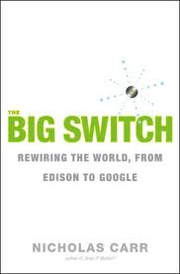
Carr: The Big Switch
“We assume that the Net’s decentralized structure is necessarily resistant to social and political control.
But, the connection of previously unconnected computers into a network governed by strict protocols has actually created “a new apparatus of control.

Slide 27
Carr: The Big Switch
“We assume that the Net’s decentralized structure is necessarily resistant to social and political control.
But, the connection of previously unconnected computers into a network governed by strict protocols has actually created “a new apparatus of control.
As the disparate pages of the Web turn into the unified and programmable database of the World Wide Computer, a powerful new kind of control becomes possible.
Even though the Internet still has no centre, technically speaking, control can now be wielded, through software code, from anywhere…acts of control become harder to detect and those wielding control more difficult to discern.”

Slide 28

Technology is amoral & inventions are routinely deployed in ways their creators neither intended nor sanction

Slide 29
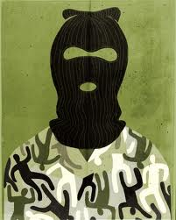
For terrorists, the Internet provides easy access to maps photographs, descriptions of weaponry & other valuable tactical information
It is an all-purpose communications network, surveillance medium, propaganda channel & recruiting tool, freely available from anywhere in the world

Slide 30
Ownership
As computing becomes more of a utility, companies and governments may give up not only the management but the ownerships of their computer assets
They will be moved to a place where they can be maintained and operated at the lowest cost
Do countries trust foreign governments, some of which my be unstable or even unfriendly to safeguard sensitive data about the operations of their companies and the lives of their citizens?

Slide 31
The New Economy
2006. YouTube sold $1.65B
60 employees
Compare Disney 133,000 people
Compare
Skype
2005. 53 mil customers, sold to Ebay $2.1Billion, more than twice number of cuustomers than BT, yet Skype employed just 200 people vs. 90,000 BT people

Slide 32
From Many to Few
There are some who believe that IT as it continues to gain momentum will begin to close the gap that up to now it has helped widen
But when we take into account the replacement of skilled as well as unskilled workers with software, the ability of companies to aggregate volunteer labour and harvest its economic value

Slide 33
From Many to Few
The erosion of the middleclass many well accelerate, as the divide widens between a relatively small group of extraordinarily wealthy people – the digital elite – and a very large group of people who face eroding fortunes
In the new AI economy, everyone is free to play but only a few will reap the rewards
(see articles on Brightspace)

